Slide 1

THE FUTURE OF IN-ROOM TECHNOLOGIES

Slide 2


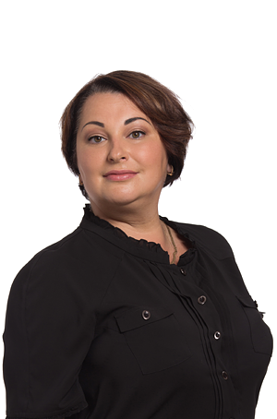



The partner who is trusted
We are a team of passionate people offering innovative products to improve hospitality industry and traveler’s experience.
We are developing new technologies so that our customers could communicate with their guests in the best way – before, during and after their stay.

Slide 3


We create smart solutions which help hotel guests to receive the most positive emotions of their stay.
Mobile
Applications
(IN-ROOM AND STANDALONE)
Interactive solutions for lobbies
Premium IPTV systems
Innovative digital signage solutions
High speed Internet access

Slide 4














More than 900 hotels
in Russia and CIS are SMARTEQ customers. This includes hotels of large international chains, such as Rezidor, Marriott, IHG, Hilton, Hyatt, Four Seasons and others.

Slide 5
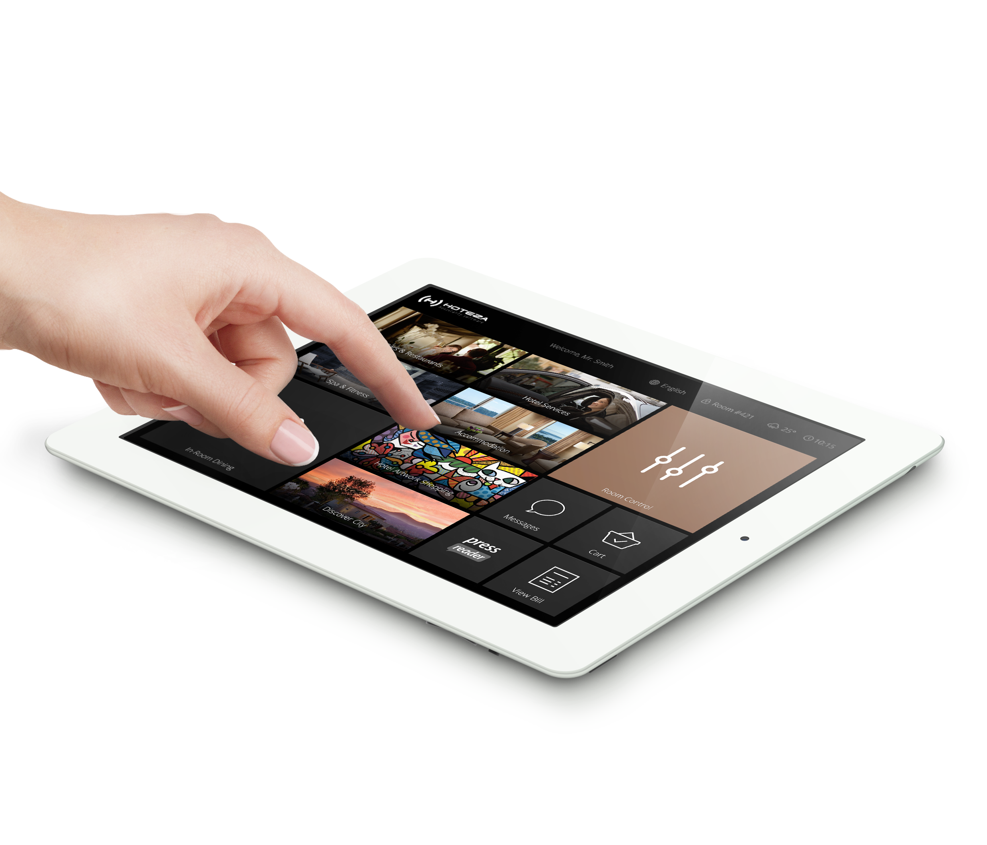
Major
benefits

Slide 6




Single system
Centralized system of TV broadcasting and Internet access. Various content sources – DVB-S/ DVB-C / DVB-T2 / IPTV / CHDMI sources /
Internet channels (video and audio).
Remote TV management
Remote management of all TVs in your
properties (settings, channel map, etc.).
No need in one-by-one TV configuration.
Remote TV monitoring.
Special prices
Thanks to frame agreements with vendors
(LG, Samsung, Ruckus) we are able to offer
you special conditions and prices.
Investment protection
Buying professional TVs with technical support
of B2B level, your investment is guaranteed
for many years.

Slide 7
Fully integrated with PMS systems
Integration with Micros Opera/Fidelio, Infor, WestSoft and others.
Automated switching on at check-in, automated guest language, view bill feature, wake-up call, messages and other features.
PMS

Slide 8

Saving costs and automation of processes
All information and images normally printed in guestroom compendiums are now digitized and current – thus saving thousands in printing.
Automation of processes cuts costs related to Concierge and Call-Centre staff by reducing the number of guest requests handled in person or by phone.

Slide 9
Professional 24/7/365 support
We provide a service “don’t call us, we’ll call you” – via remote online monitoring, Hoteza is aware of software and hardware problems before your in-room guest.
Via Service Level Agreements (SLA) we make a commitment to all of our customers. These clearly defined actions and response times are easily measurable, and we will raise our hands if we have failed to keep our promises.
24/7

Slide 10

Communication with hotel staff
A built-in messenger allows your guests to communicate with hotel staff and even directly with the hotel manager, and vice-versa. Hoteza TV guarantees that you receive the most accurate and genuine feedback from your guests!
The Questionnaire module allows you understand and analyze your guests’ needs and instantly increase the guest satisfaction level.

Slide 11
THE VARIETY OF
GUEST-FACING SOLUTIONS

Slide 12
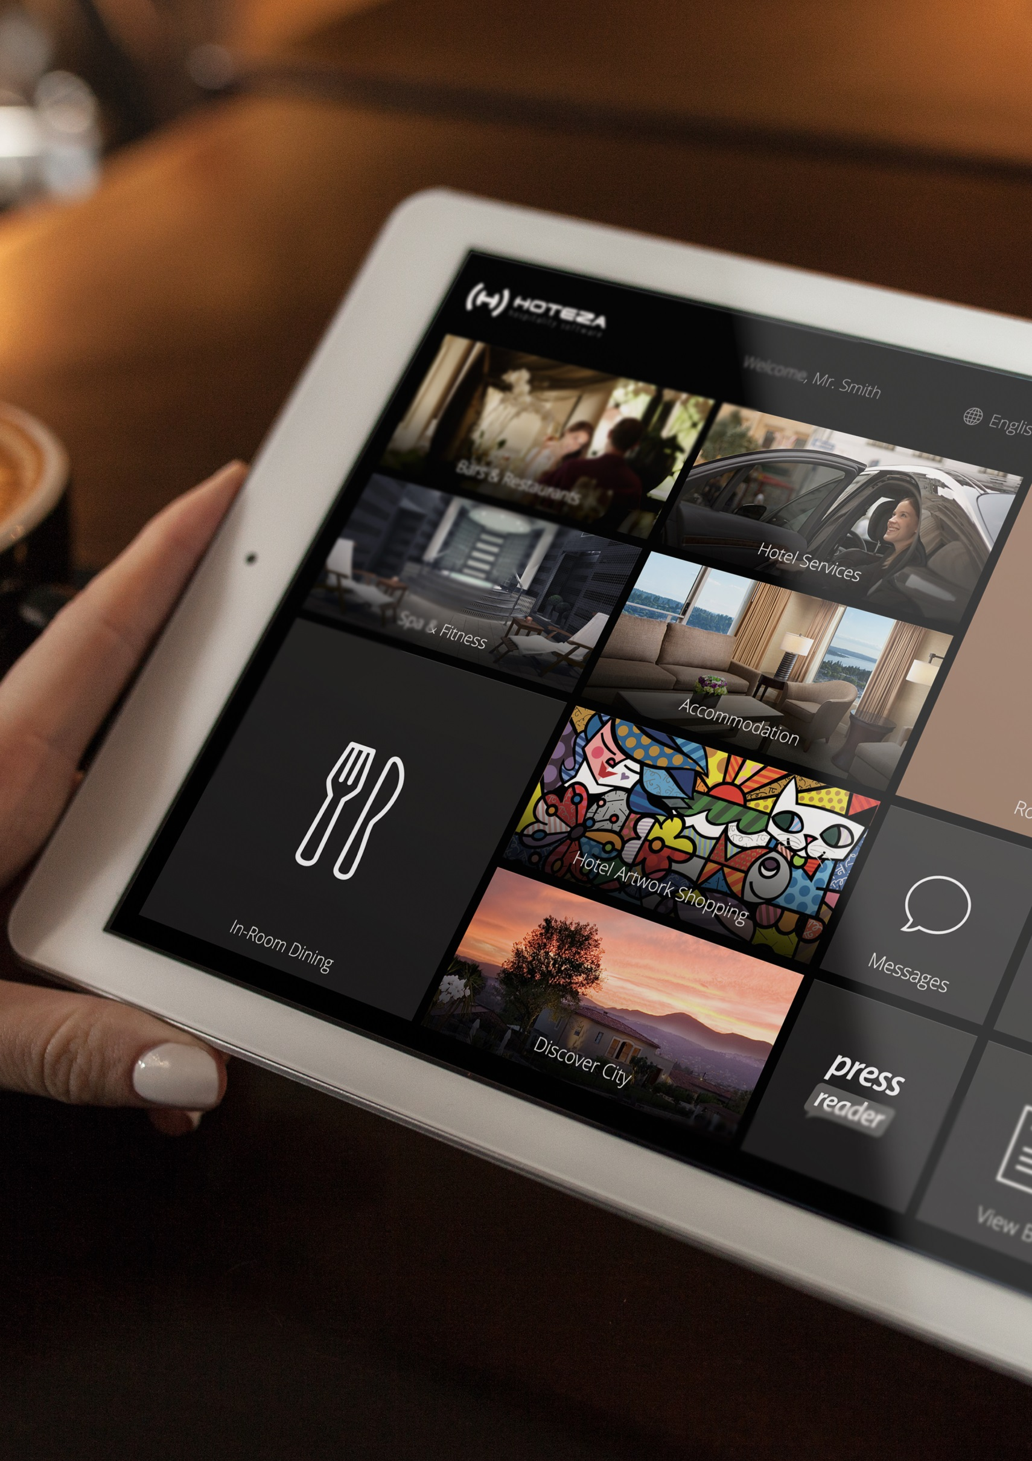
HOTEZA HOTPAD: In-room tablets for even better guest experience
With Hoteza it’s possible to have in-rooms tablets in your guestrooms which will work under management of the single CMS, the same which manages the content for TV screens and mobile applications.

Slide 13
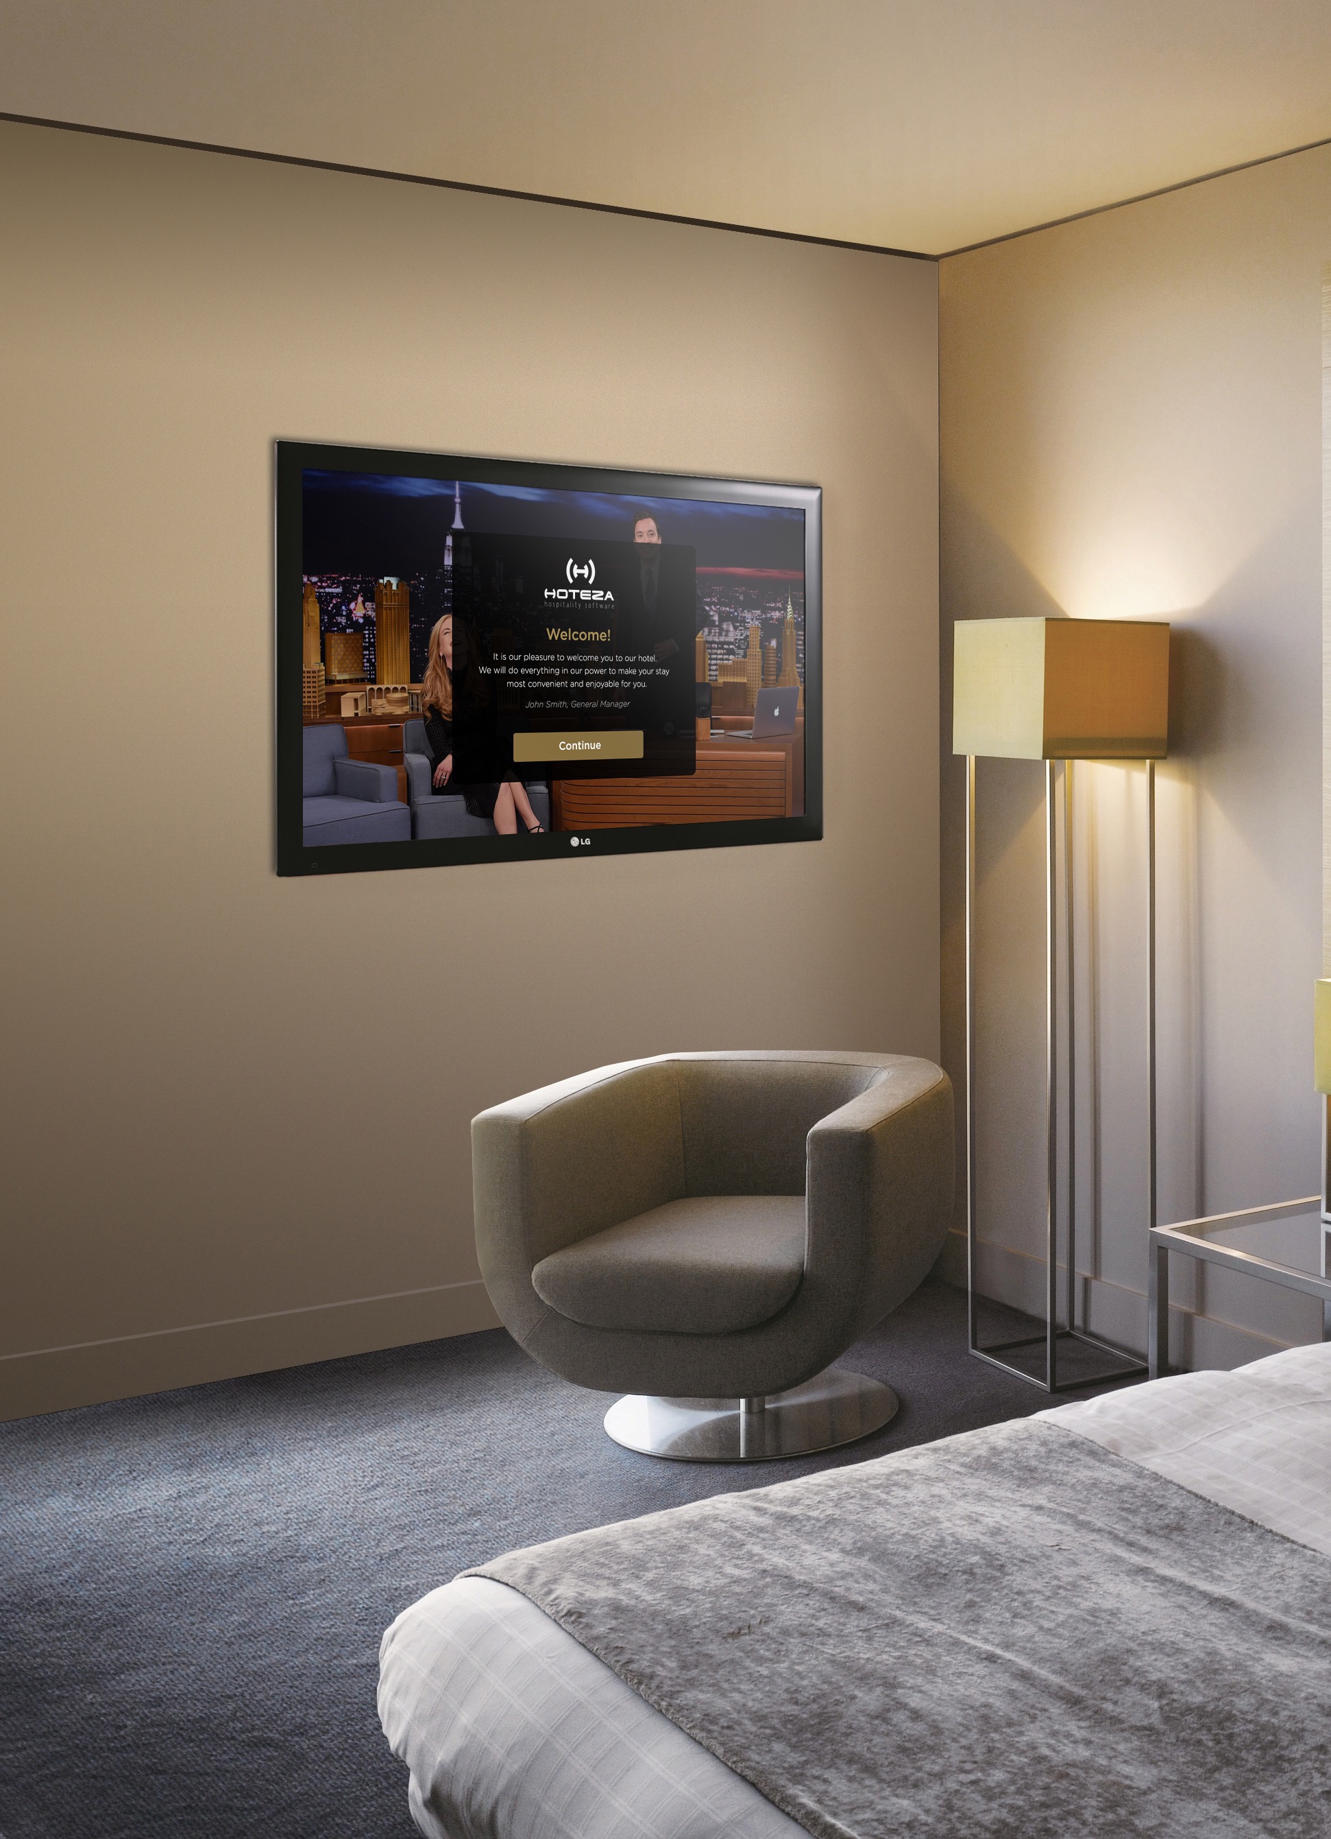
HOTEZA TV:
A Set-top box free SOLUTION
With no STB to consider, you can mount the TV closer to the wall and have the freedom of choice to place it exactly where you want. Also absence of STB decreases the risk of malfunctioning to zero.
STB solution is also available for non-compatible TVs, i.e. for bathroom TVs or for large screens in public areas.

Slide 14
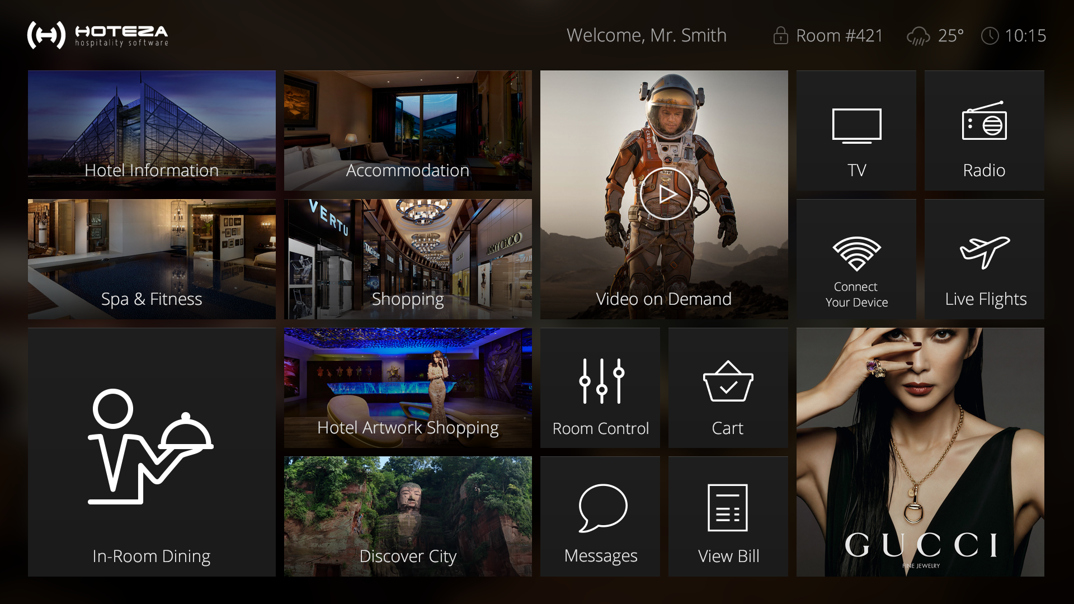

Slide 15
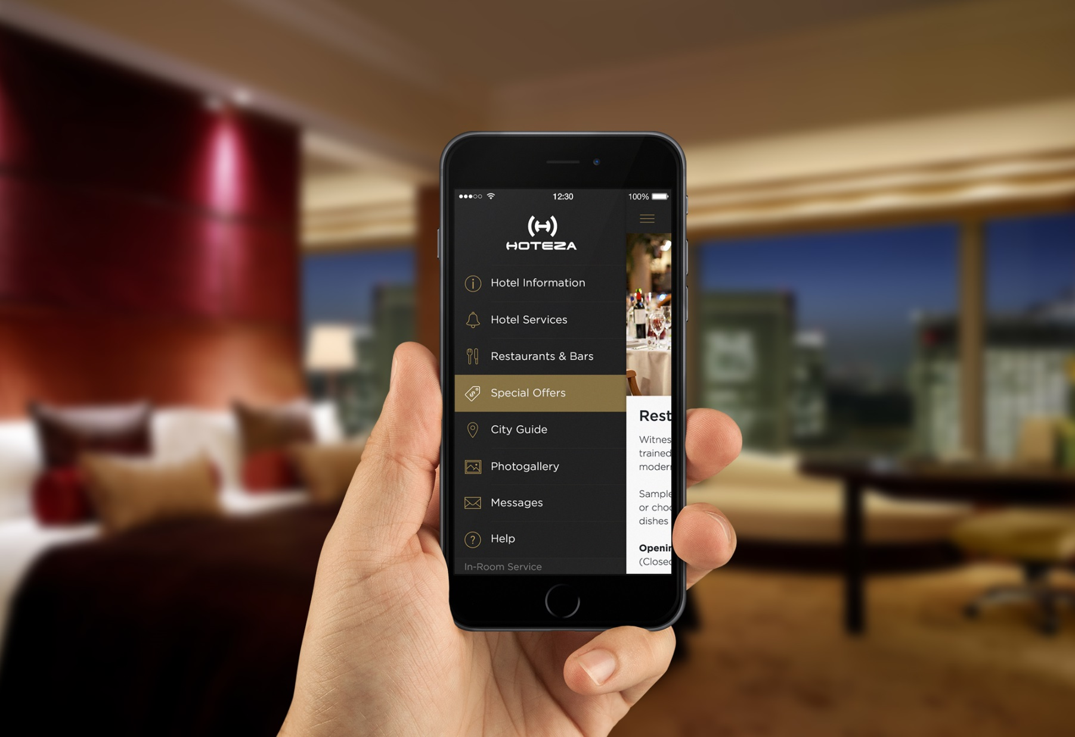
HOTEZA MOBILE:
ALL HOTEL
AT A TOUCH:
Hoteza Mobile — a mobile hotel application for improving communication with hotel guests and creating revenue opportunities.
The application is downloaded and installed onto guests’ devices in just few seconds allowing them to use hotel services in an easy and fast way
without having to call or ask reception.

Slide 16
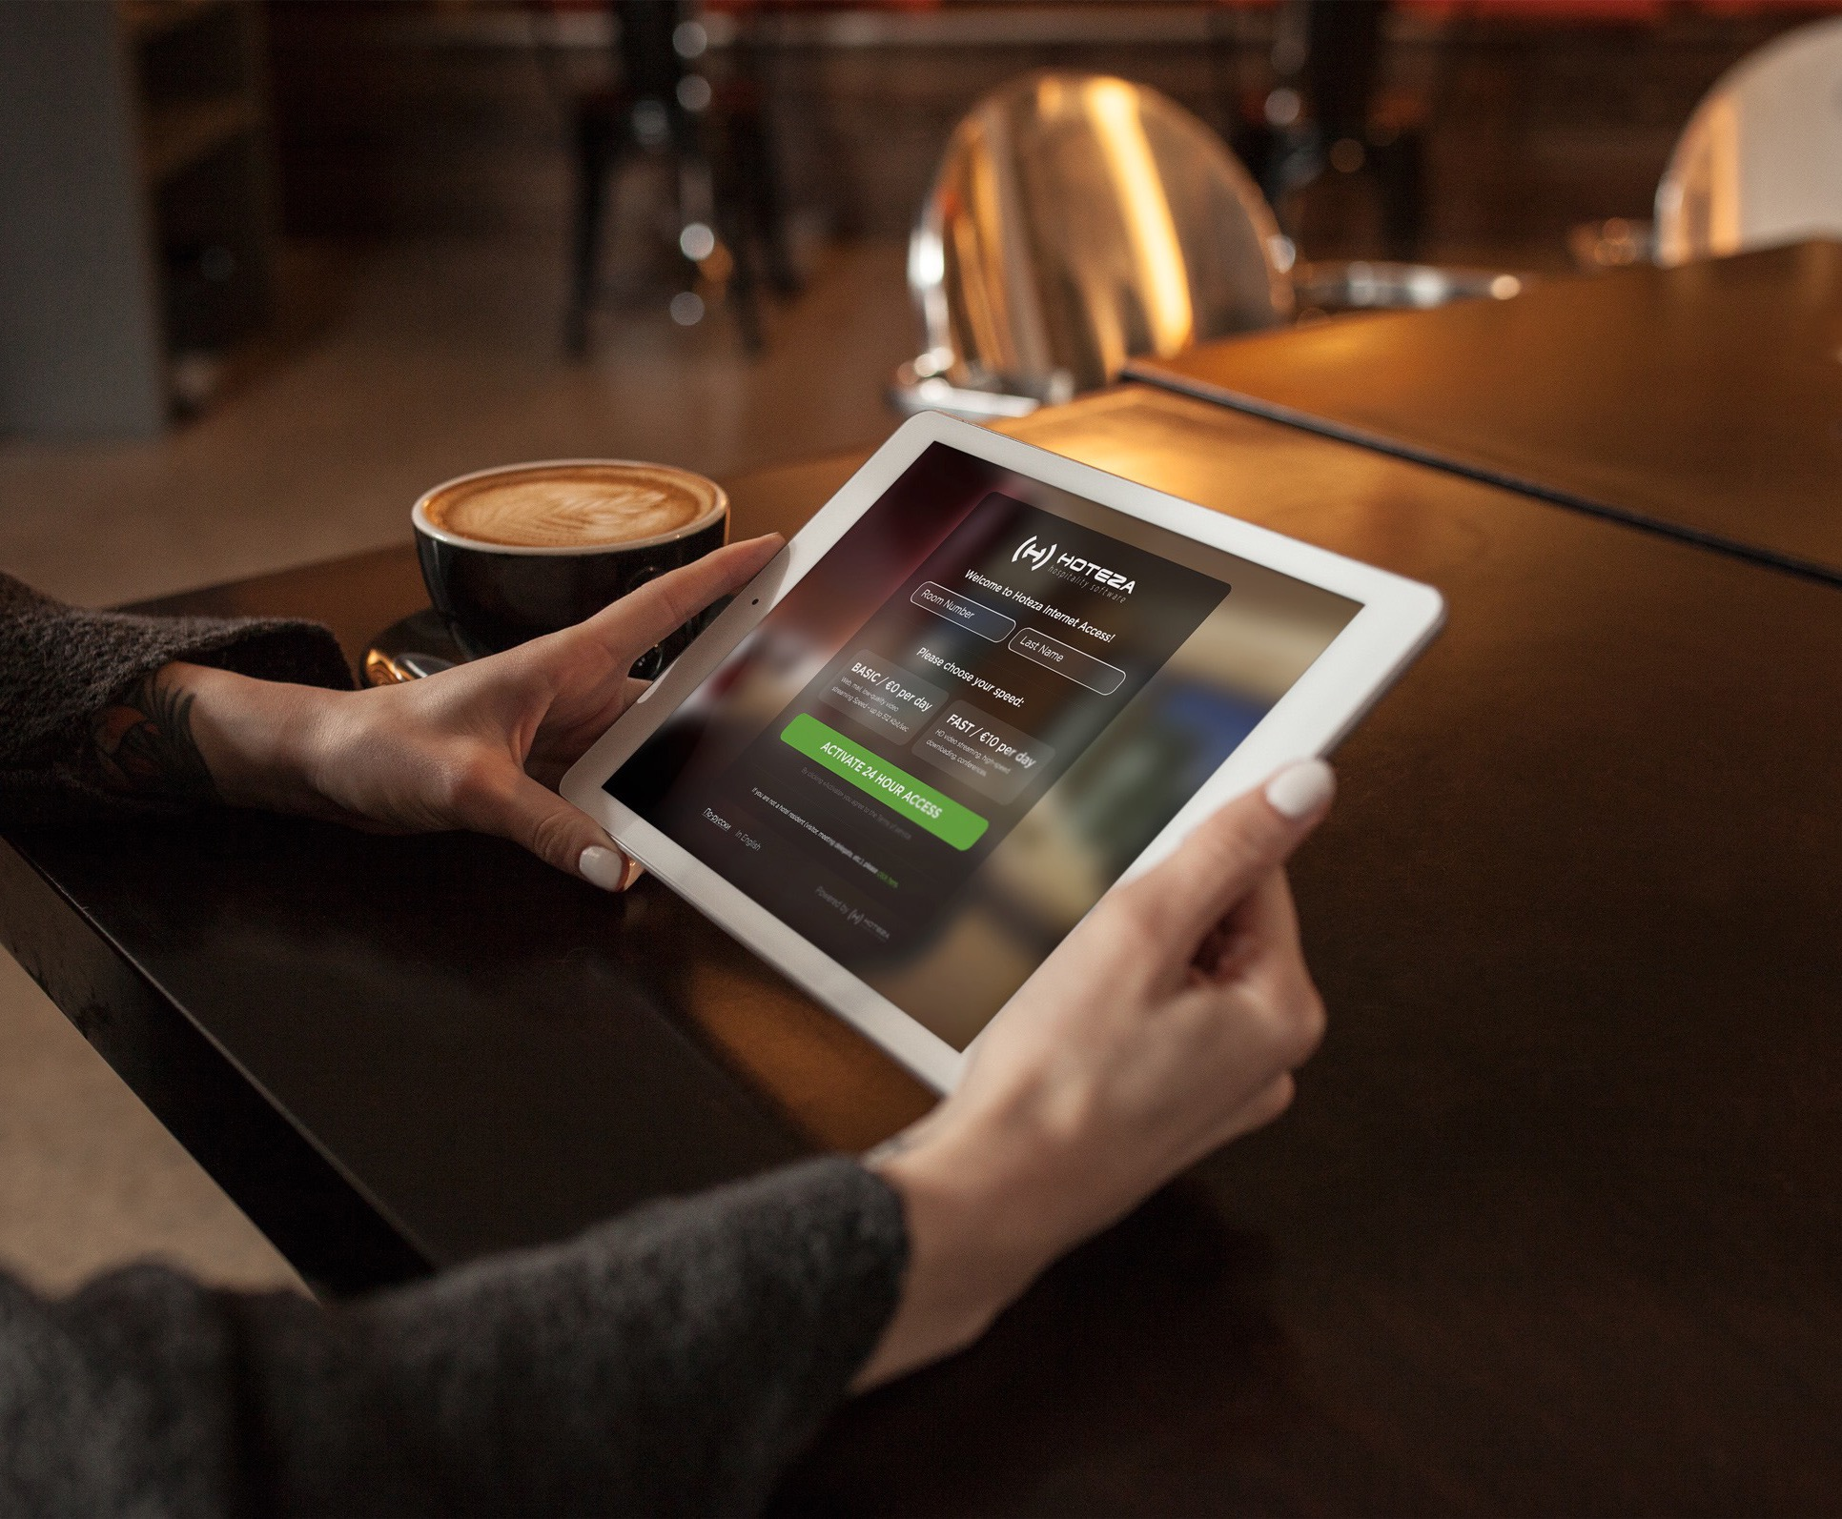
HOTEZA HSIA:
High-speed Internet Access
All you need to do is to enter room number / last name or mobile phone number. Thus Hoteza HSIA solves
the problem of overload Internet channel and fairly distributes the speed among users.

Slide 17
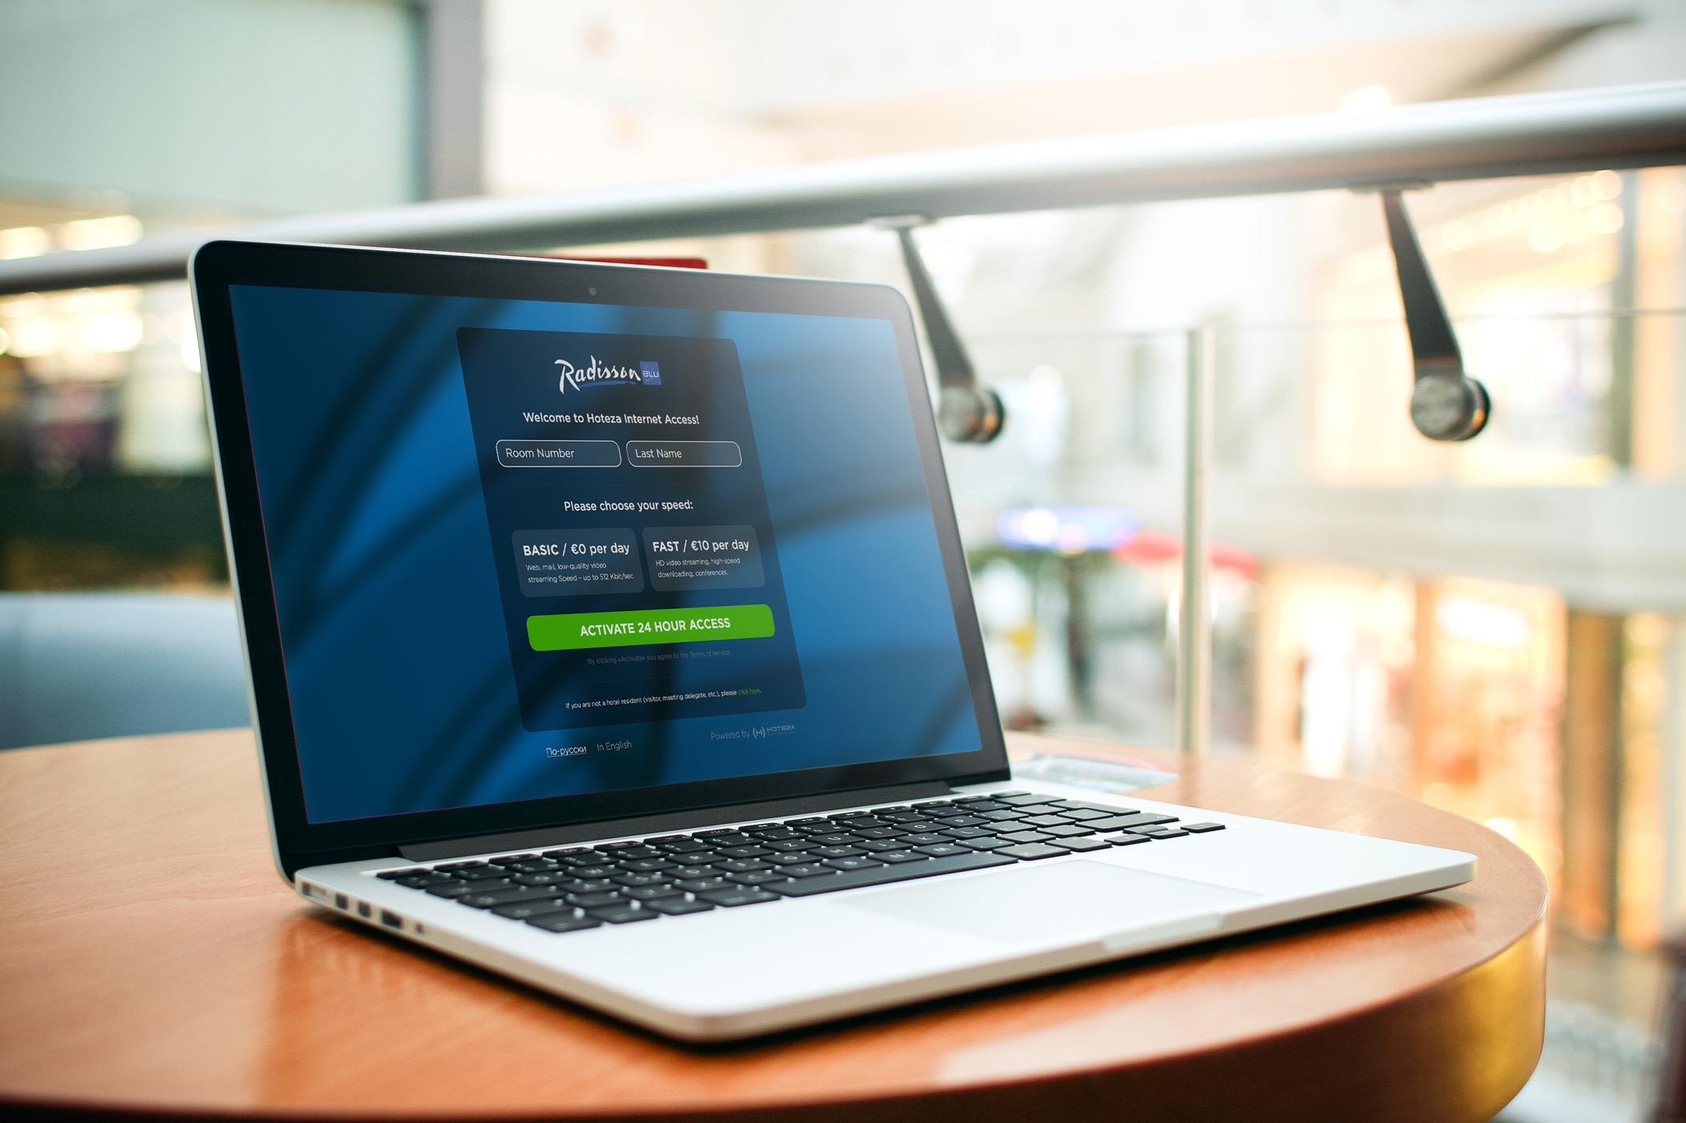
Brand support
The landing page can be branded in accordance
with the corporate style of the hotel.

Slide 18
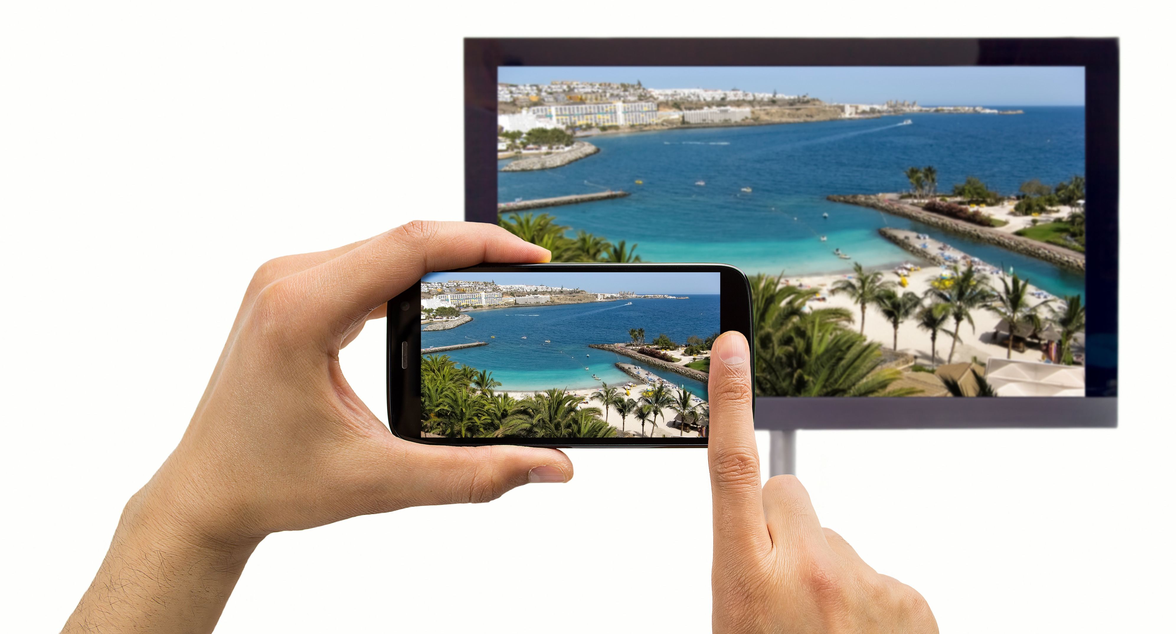
Bring-your-own-device (BYOD) technology*
Screen mirroring by Hoteza enables the guest to mirror his devices on the TV, and push content to truly bring that home-from-home experience to his room, in HD video quality including sound.
For devices with Wi-Fi Direct support only.

Slide 19
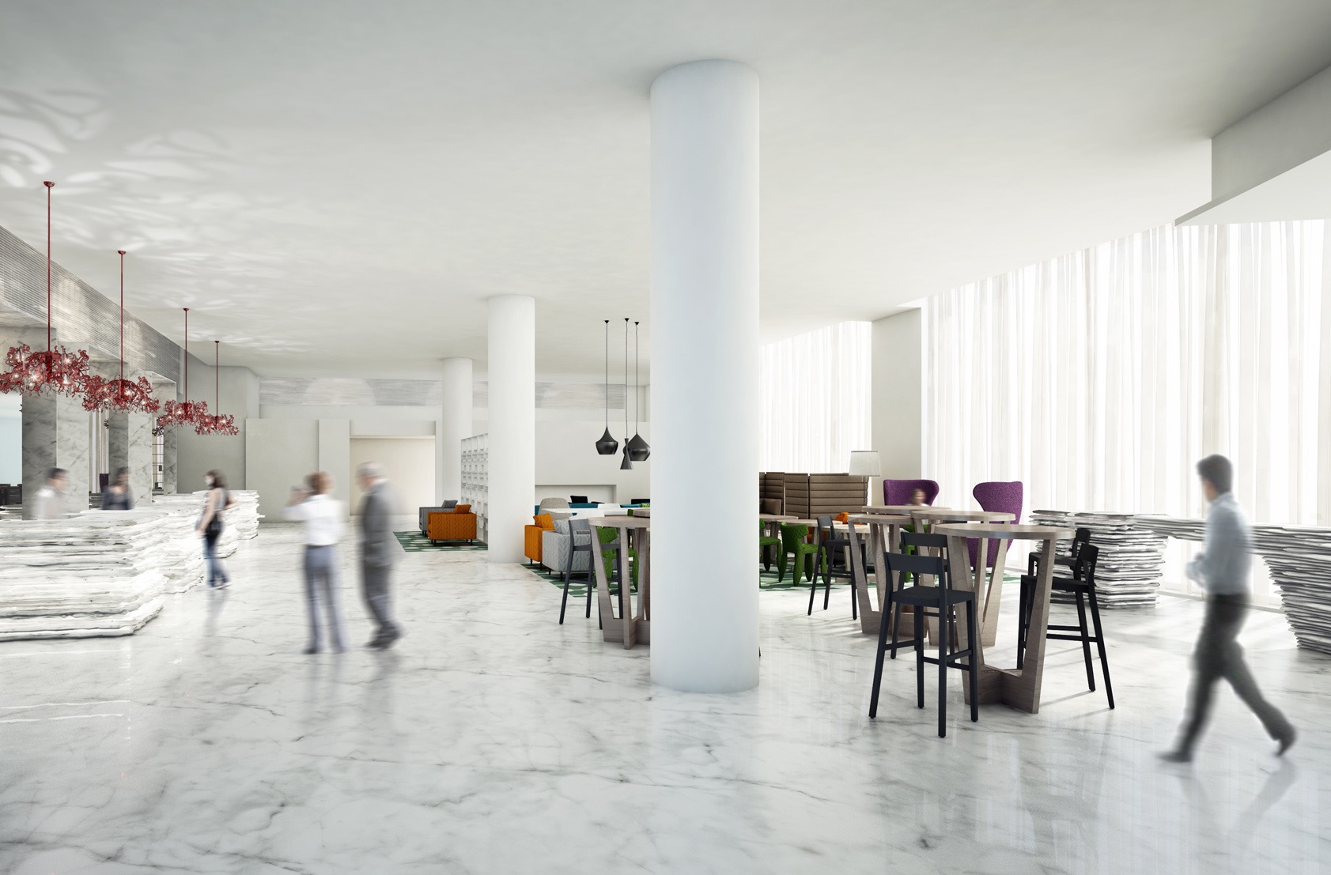
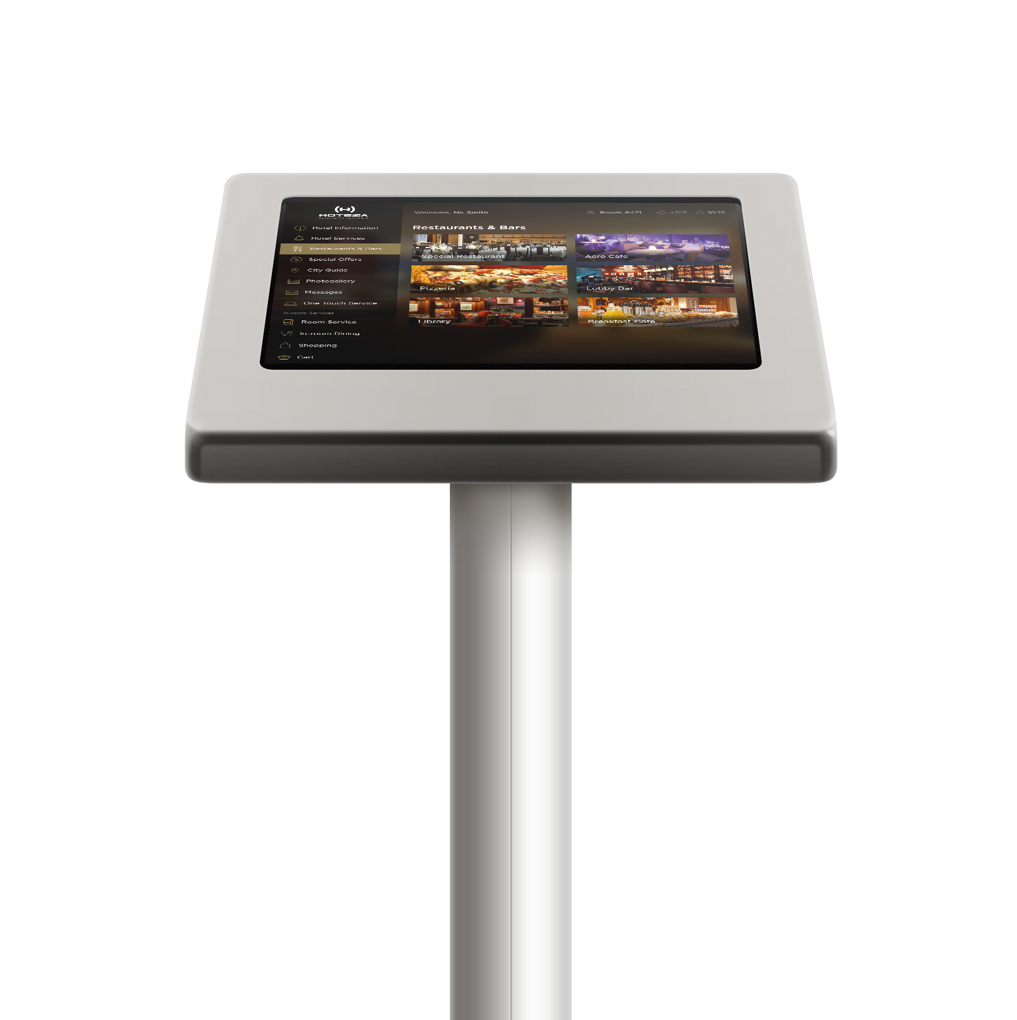
UPSALES:
Hoteza Lobby
Using Hoteza Lobby, your guests can get information on your hotel, special offer and the nearest tourist attractions, plus view flight timetables and weather forecasts.
With a user-friendly interface, the touch-screen application is simple to navigate for any user.

Slide 20
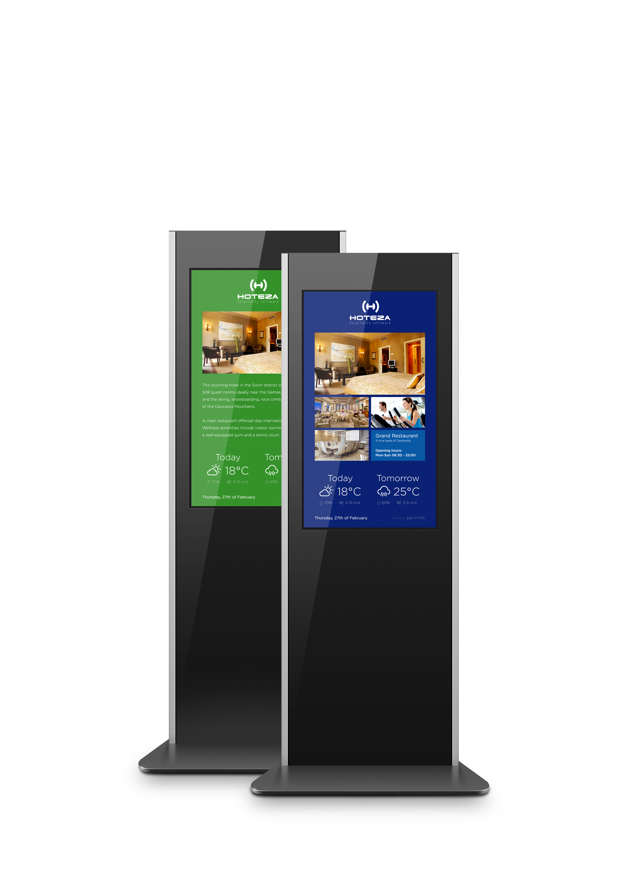
UPSALES:
Hoteza HotSign
Hoteza HotSign allows you to take advantage of transmitting audiovisual content in real time and to increase in service level.
Loading, customization and management can be performed from anywhere in the world.
Reduction in printing costs and savings on labor costs.

Slide 21
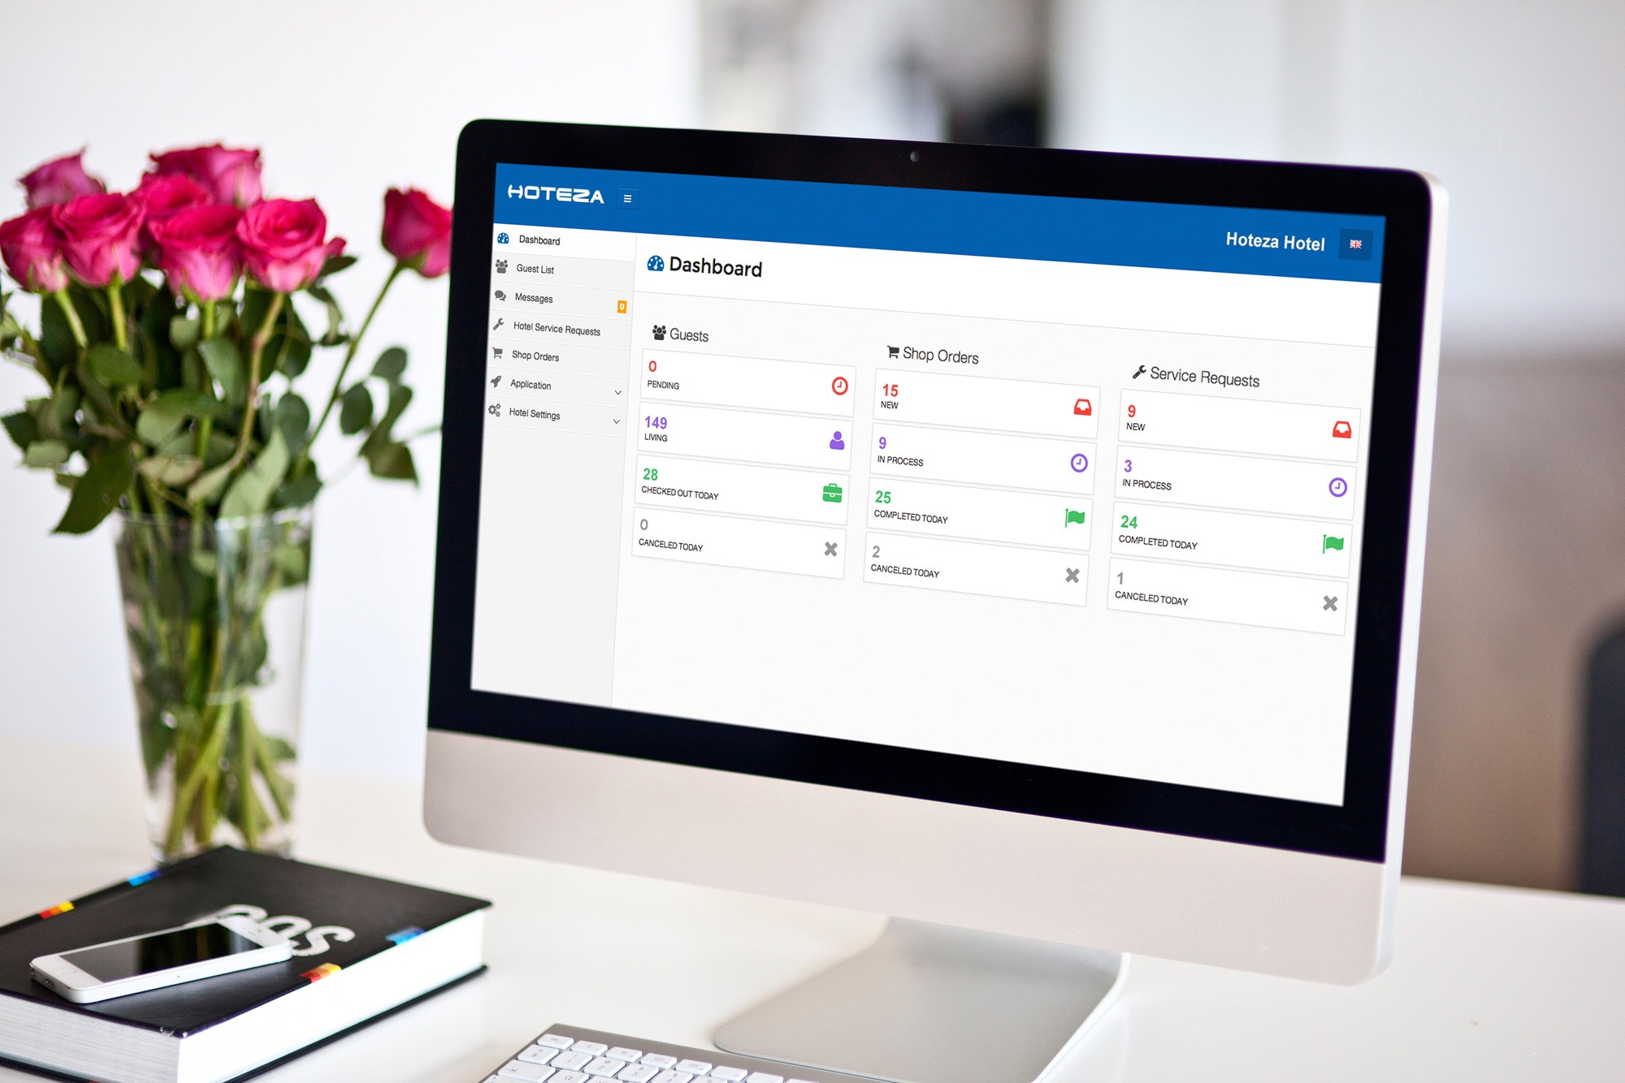
Single content management system (CMS)
All systems – Hoteza TV, Hoteza HotPad, Hoteza Mobile and others are managed through a single cloud-based back-end (Hoteza CMS) that may be accessed and operated from any point of the world.

Slide 22
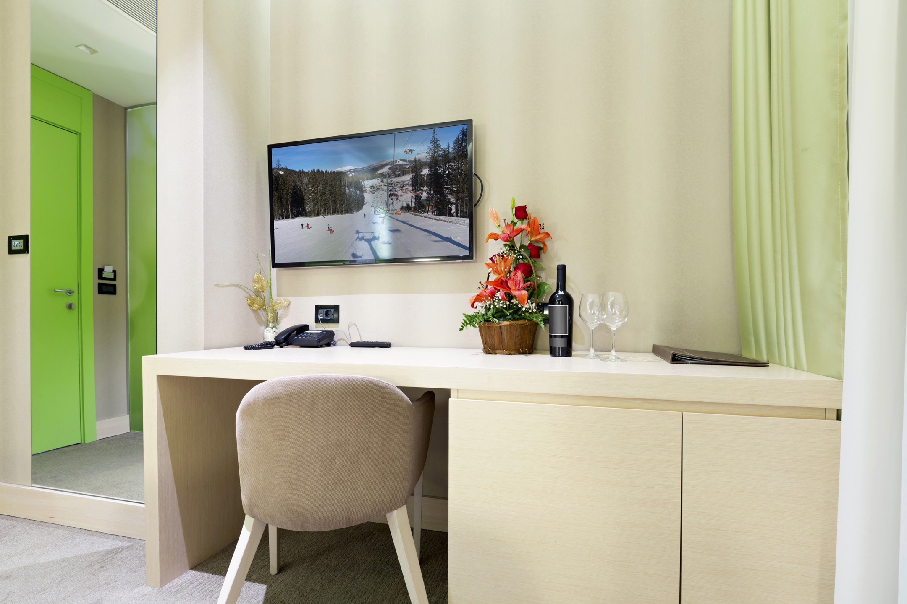
Remote management of video content
TV channels, video about resort, live-video from restarurants or ski lifts. Video content generator on schedule with streaming to screens in public areas and guestroom TVs.

Slide 23
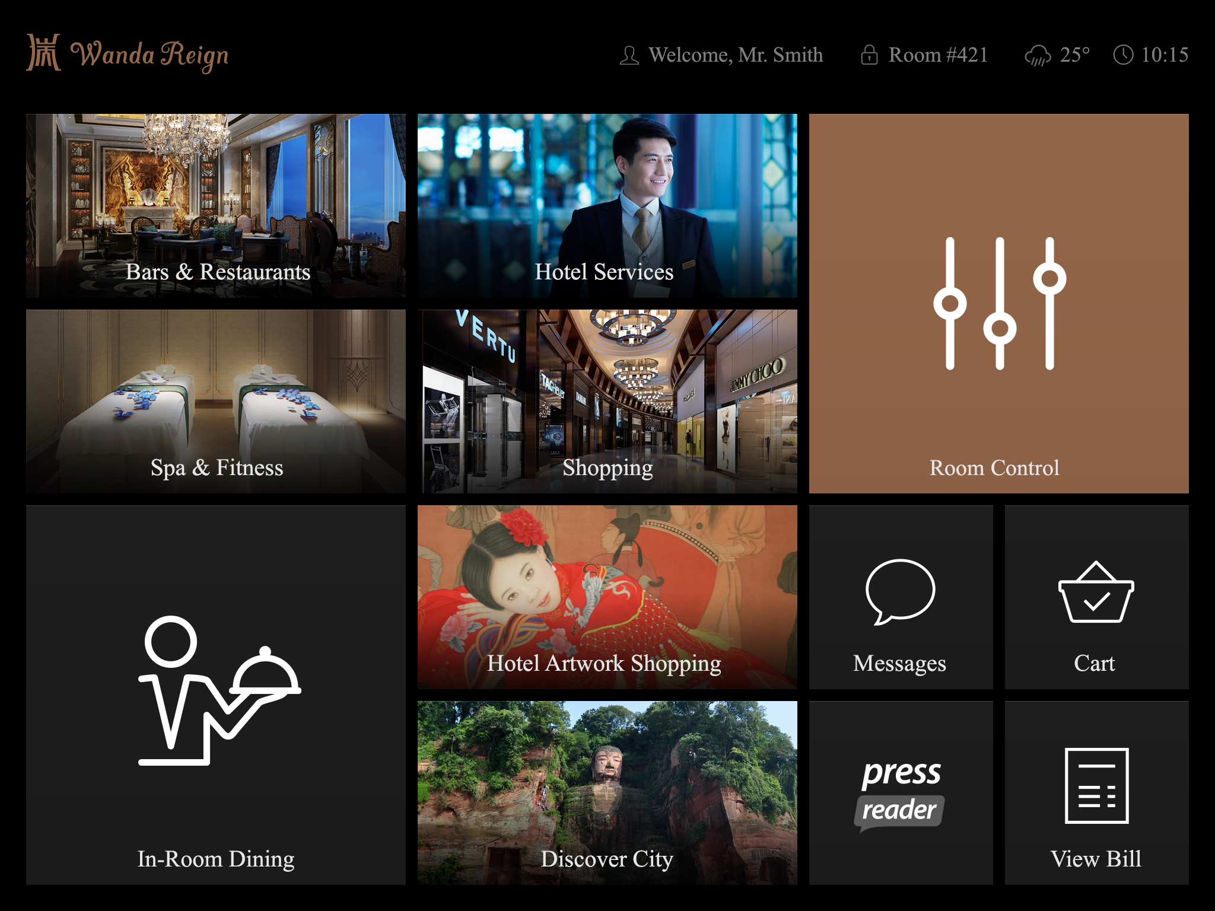
Customization
Compliance with brand standards and customized design will make help to make unique the stay of your guests.

Slide 24
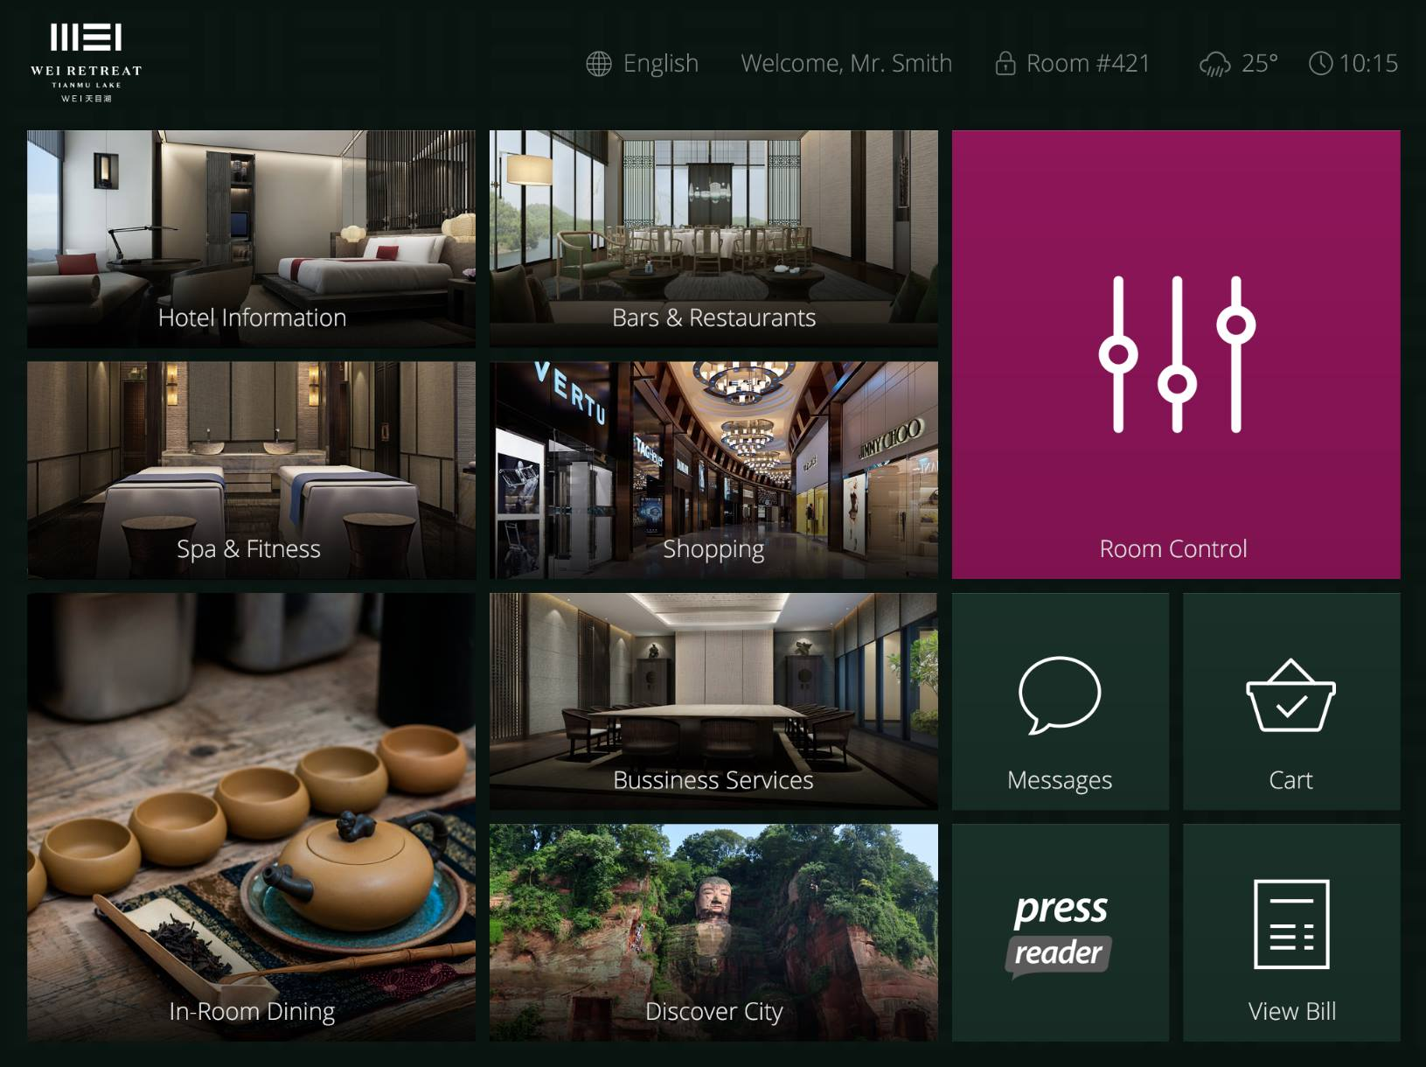
Customization
Compliance with brand standards and customized design will make help to make unique the stay of your guests.

Slide 25
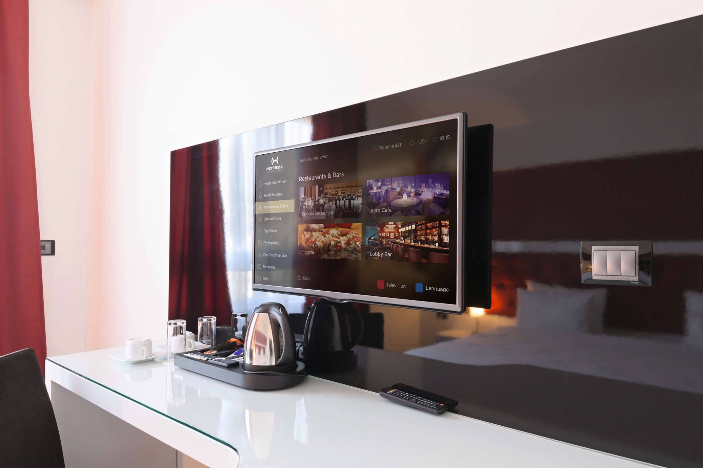
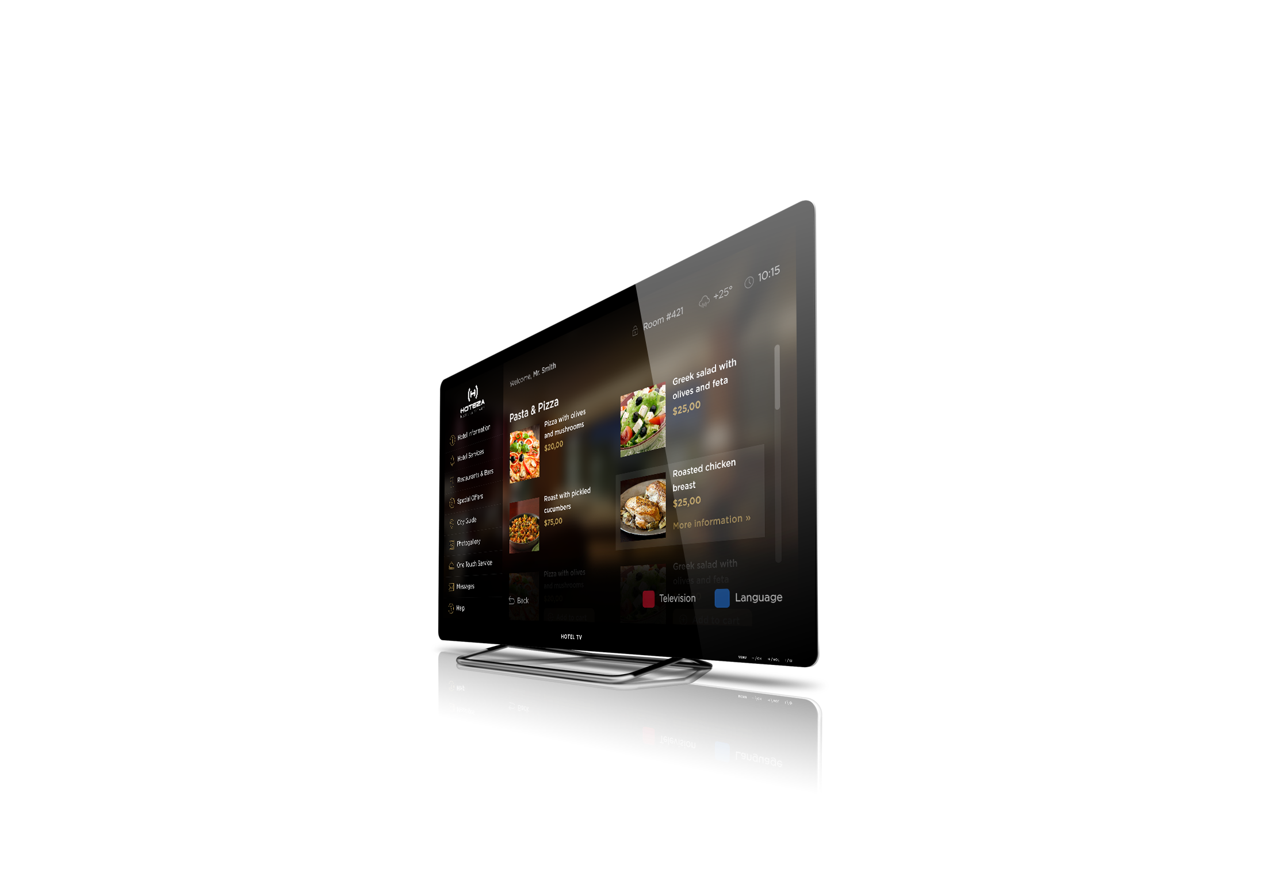
Generate
additional
revenues
As well as improving your customer service, Hoteza solutions provide the hotel with an ideal opportunity to promote and upsell your facilities and partner services thus generating additional revenue.
Hoteza enriches the guest experience and helps to increase in-room sales: Room-service breakfast or
dinner orders, or even a bottle of chilled champagne are all available to your guests via TV or in-room tablet screen or right from the guest’s own smartphone.

Slide 26
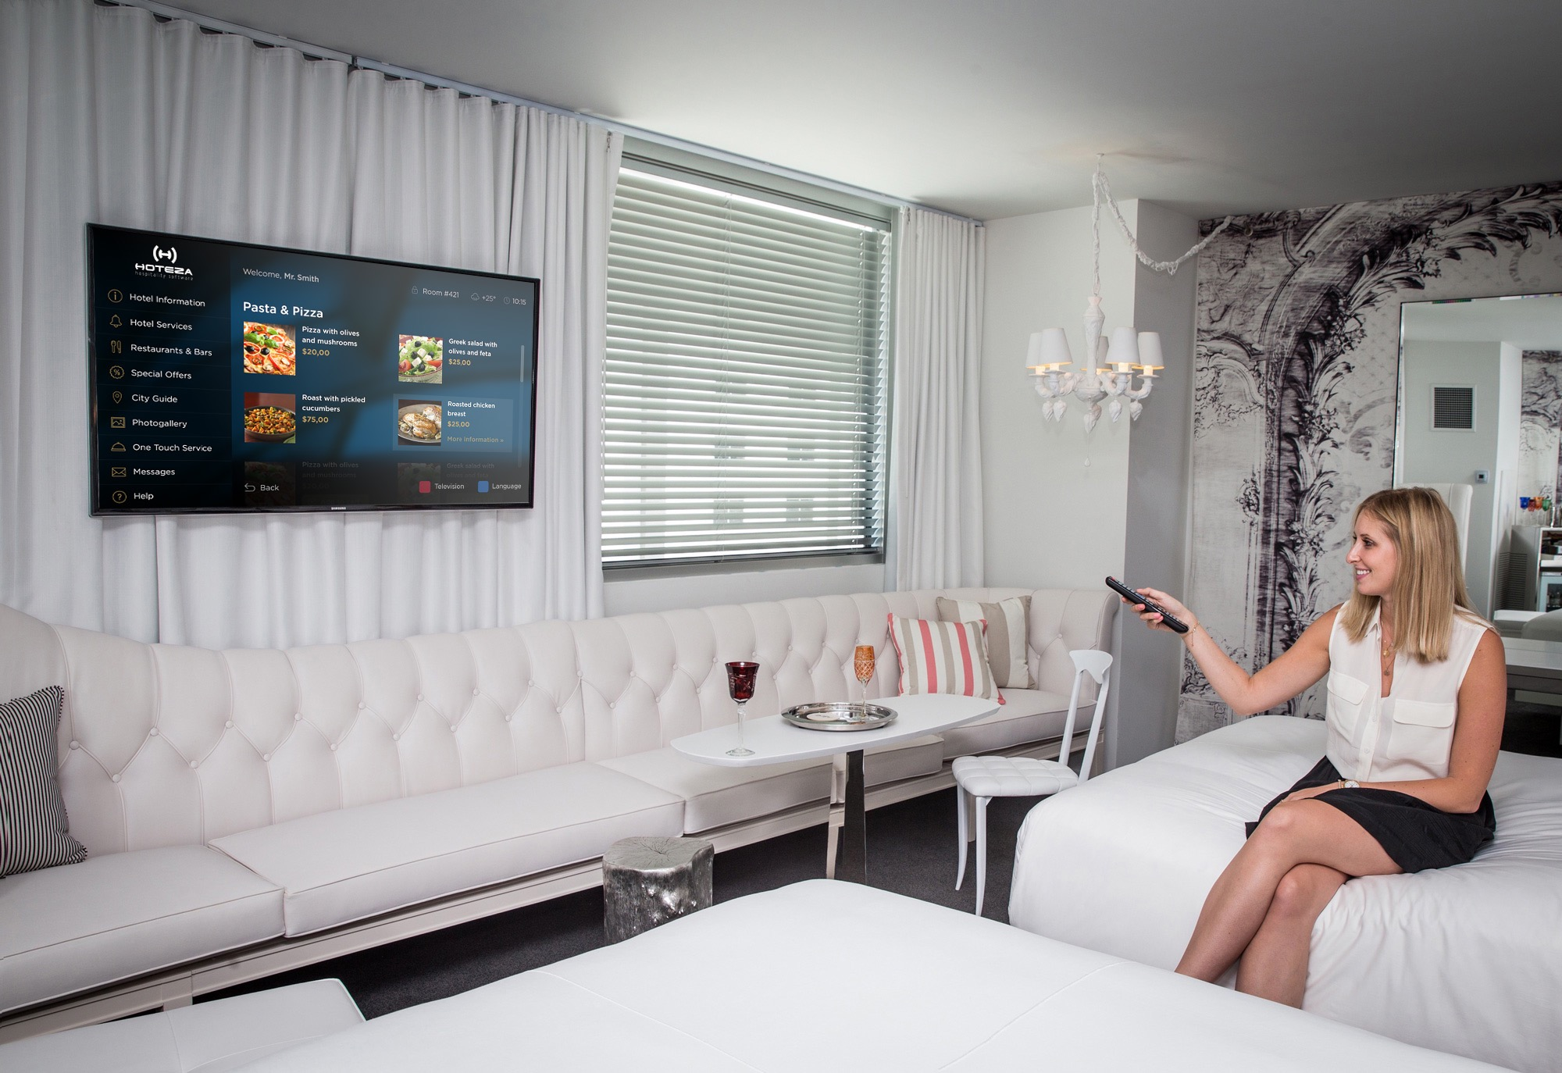
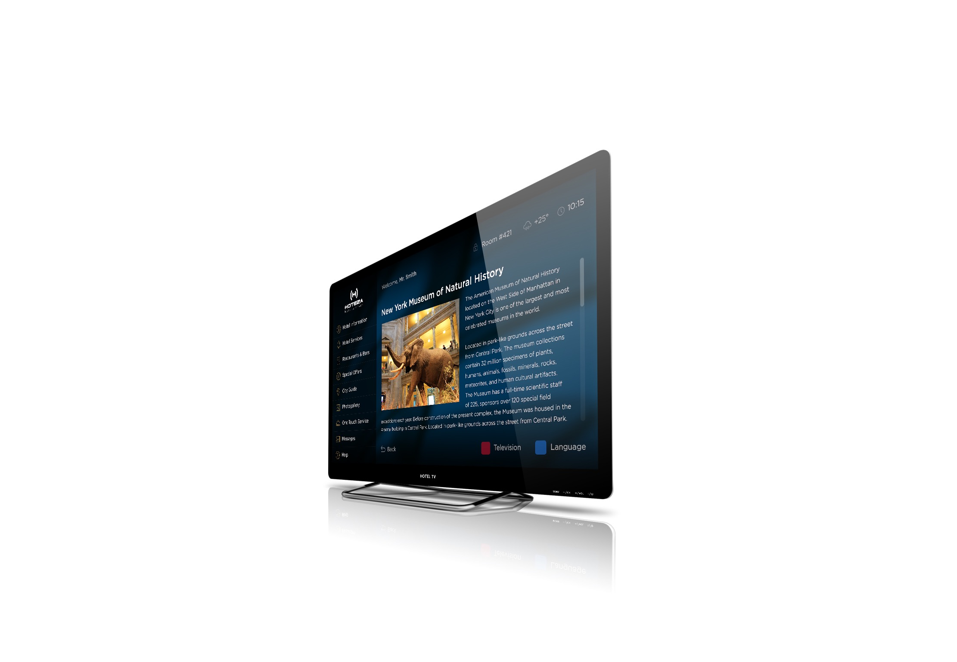
Visualize your offerings
Hoteza provides guests with comprehensive, up-to-date and visual information which is limited only by your fantasy!
You can easily make changes to the design, products, options, languages and prices in real-time without impacting your guests’ use of the service.

Slide 27
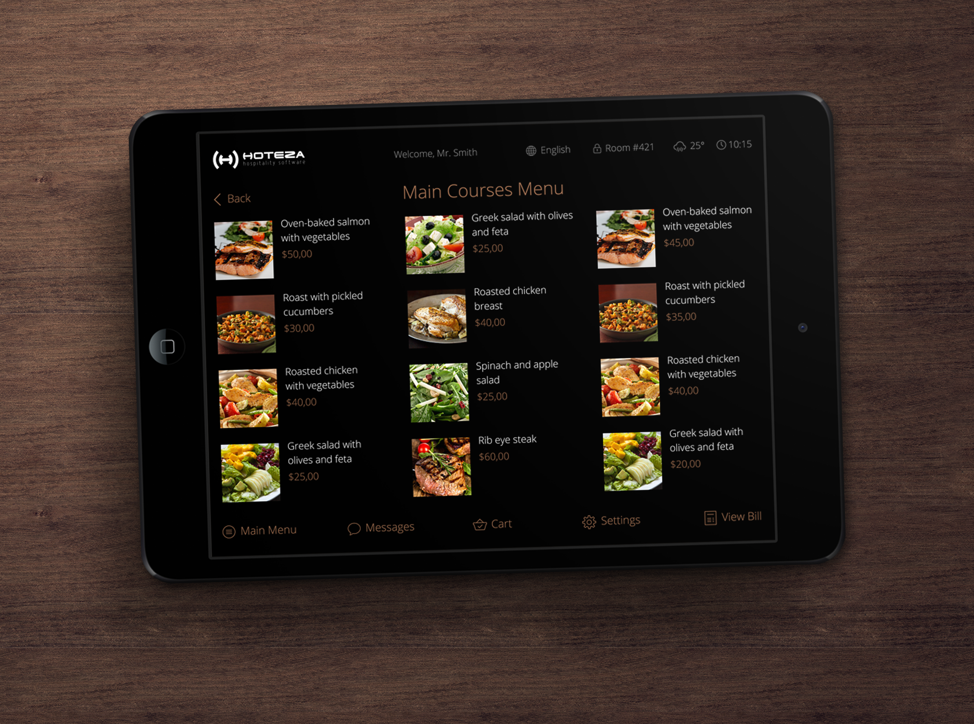

Slide 28
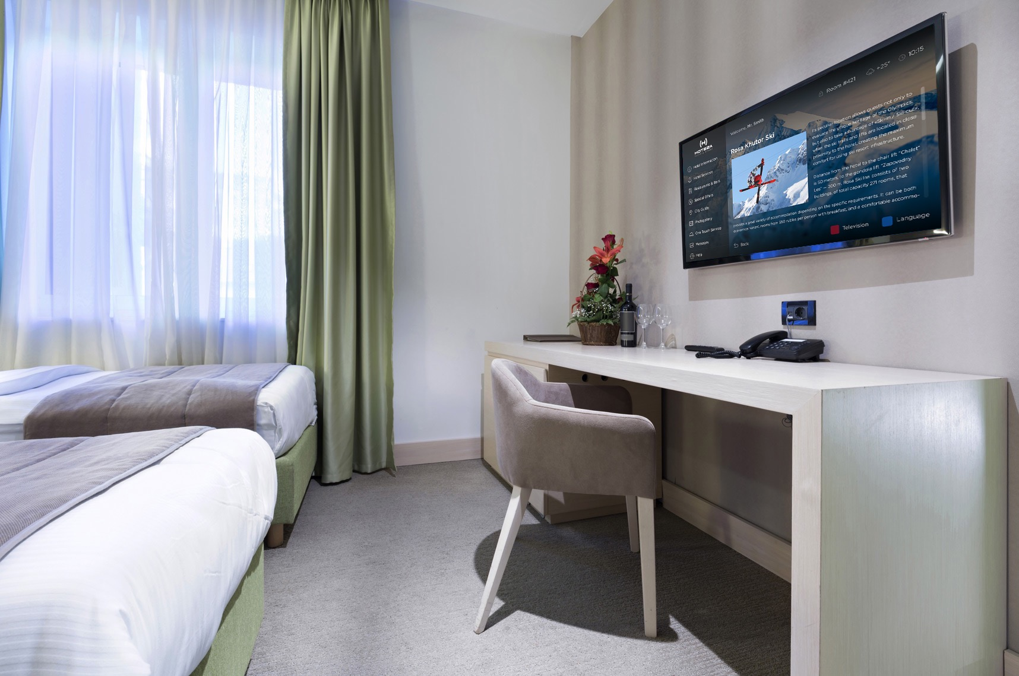
Information about hotel and the resort
Detailed information about the hotel and on resort attractions and integration with interactive maps helps to keep your guests informed about places of note and interest such as bars, restaurants, clubs and so on. All designed to save your guests’ time.

Slide 29
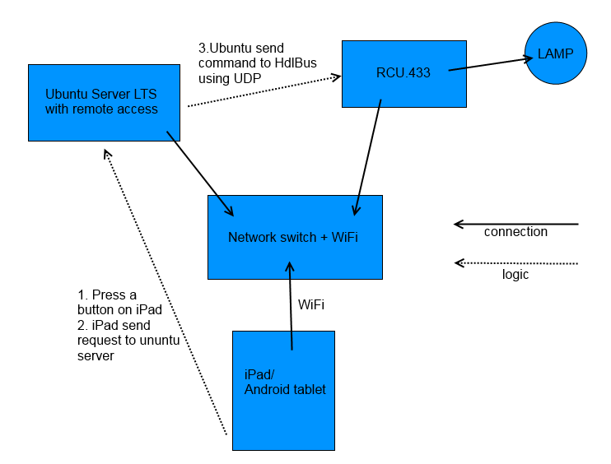
SCHEME OF HOTEZA-HDL COMMUNICATION

Slide 30
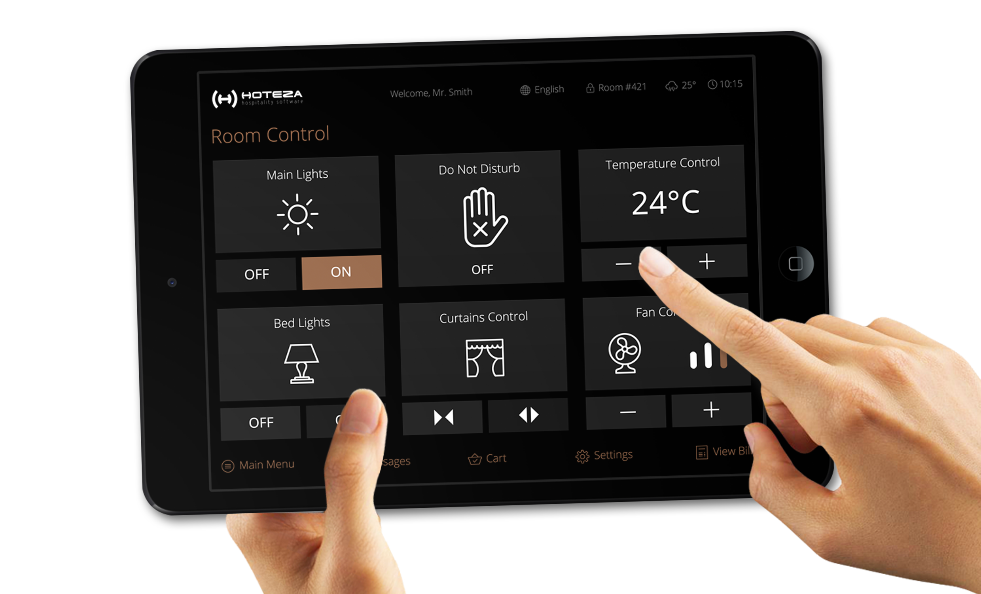

Slide 31
ROOM CONTROL
INTEGRATeD InSTALLATIONS

Slide 32
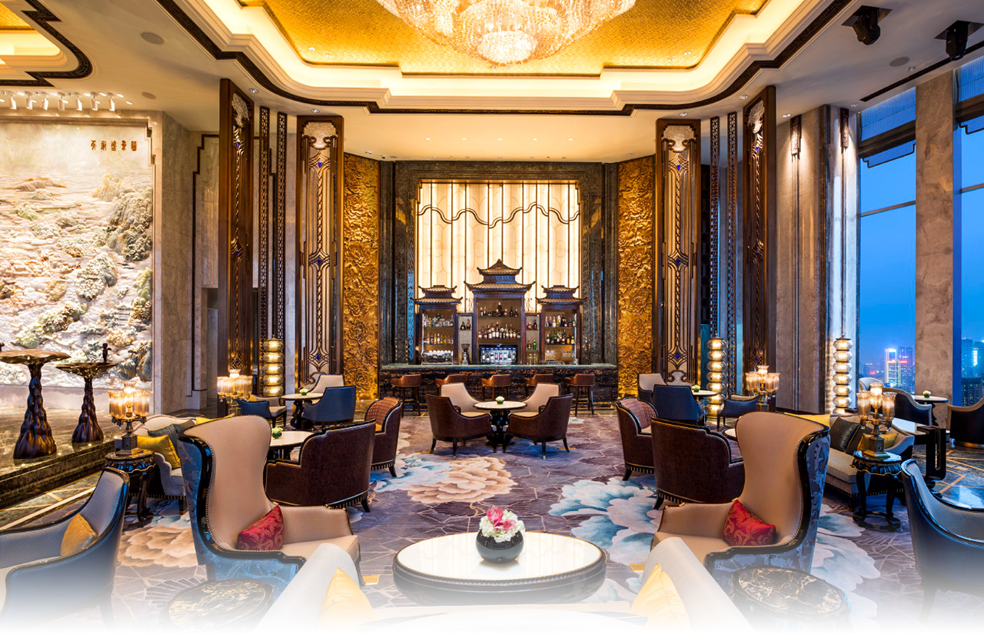
Wanda Reign Chengdu Hotel 5*
240 rooms / Chengdu / 2015
Hoteza HotPad

Slide 33

Wei Retreat Tianmu Lake Boutique Hotel 5*
50 rooms / Chengdu / 2015
Hoteza HotPad

Slide 34
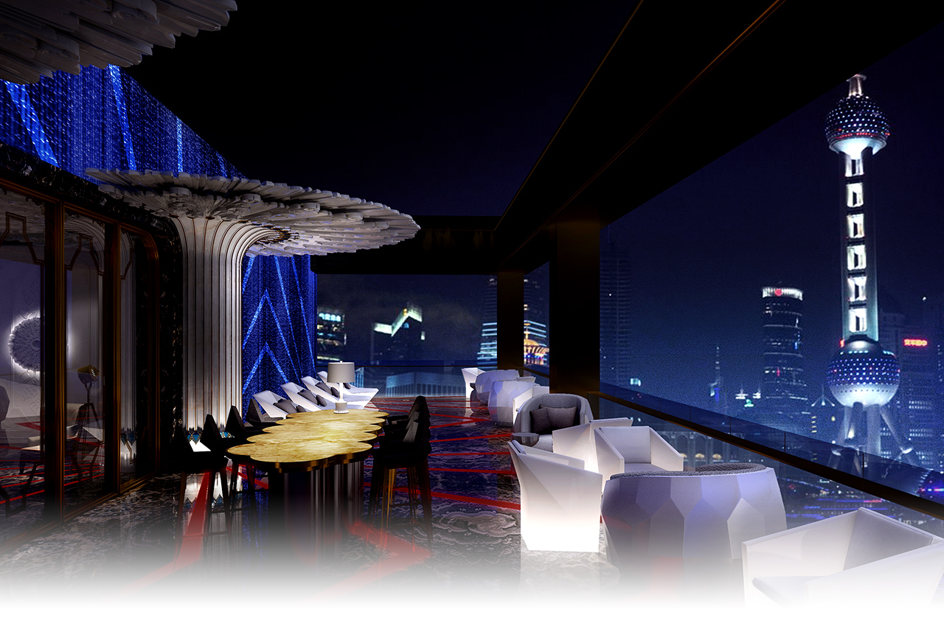
Radisson Blu Chelyabinsk 5*
211 rooms / Chelyabinsk / 2014
Hoteza TV, Hoteza Mobile, Hoteza HSIA
Wanda Reign Shanghai on the Bund 5*
193 rooms / Shanghai / 2016
Hoteza HotPad

Slide 35
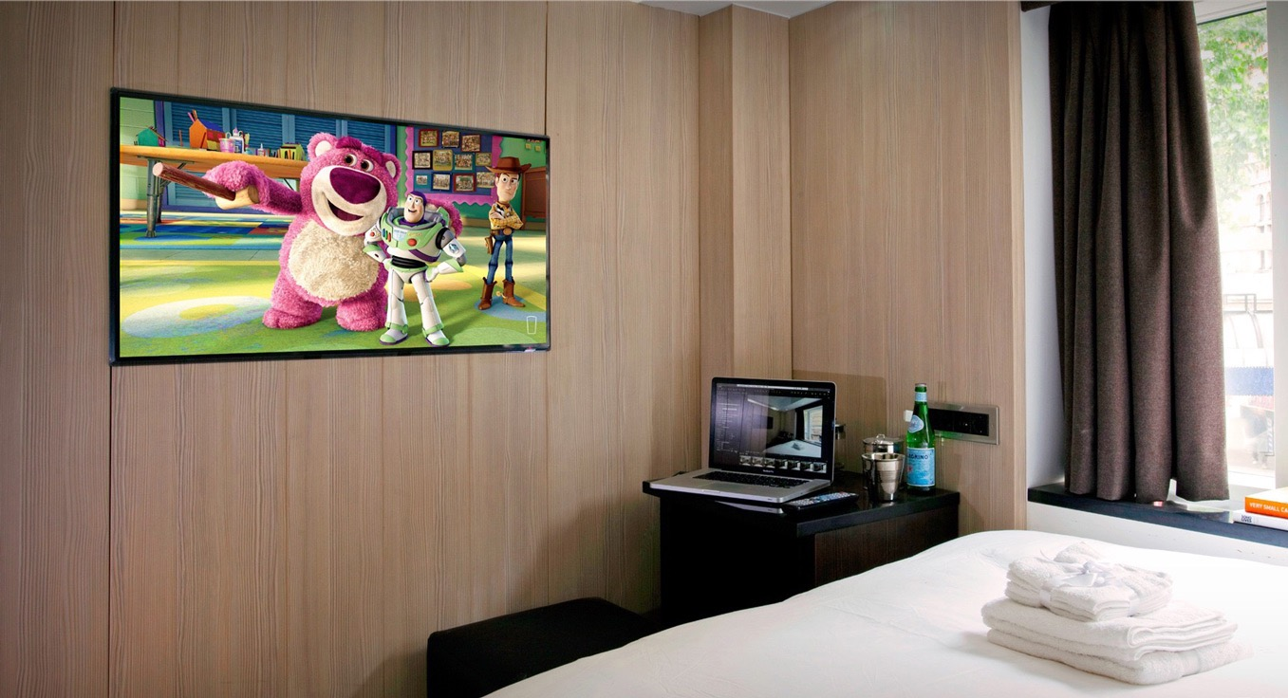
~
LG Hotel TVs

Slide 36
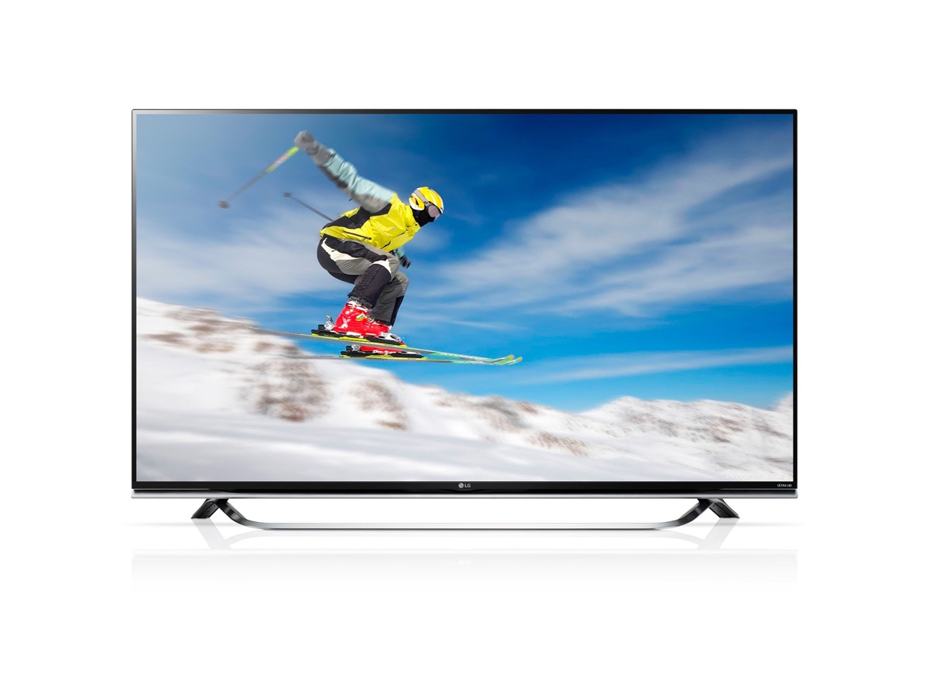
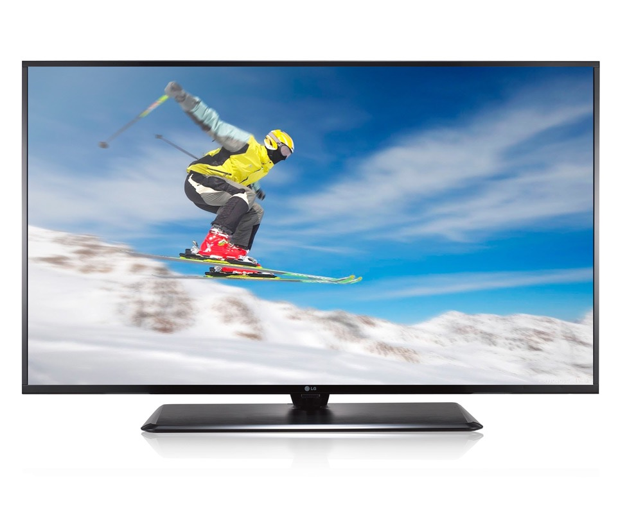
Professional hotel TVs by LG
LG LX761H
32" / 40" / 43"/ 49"/ 55"
WebOS SMART platform
LG UX960H
49” / 55” / 60”
WebOS SMART platform
CINEMA SCREEN design
ULTRA HD resolution / 3D support
Frontal speakers

Slide 37
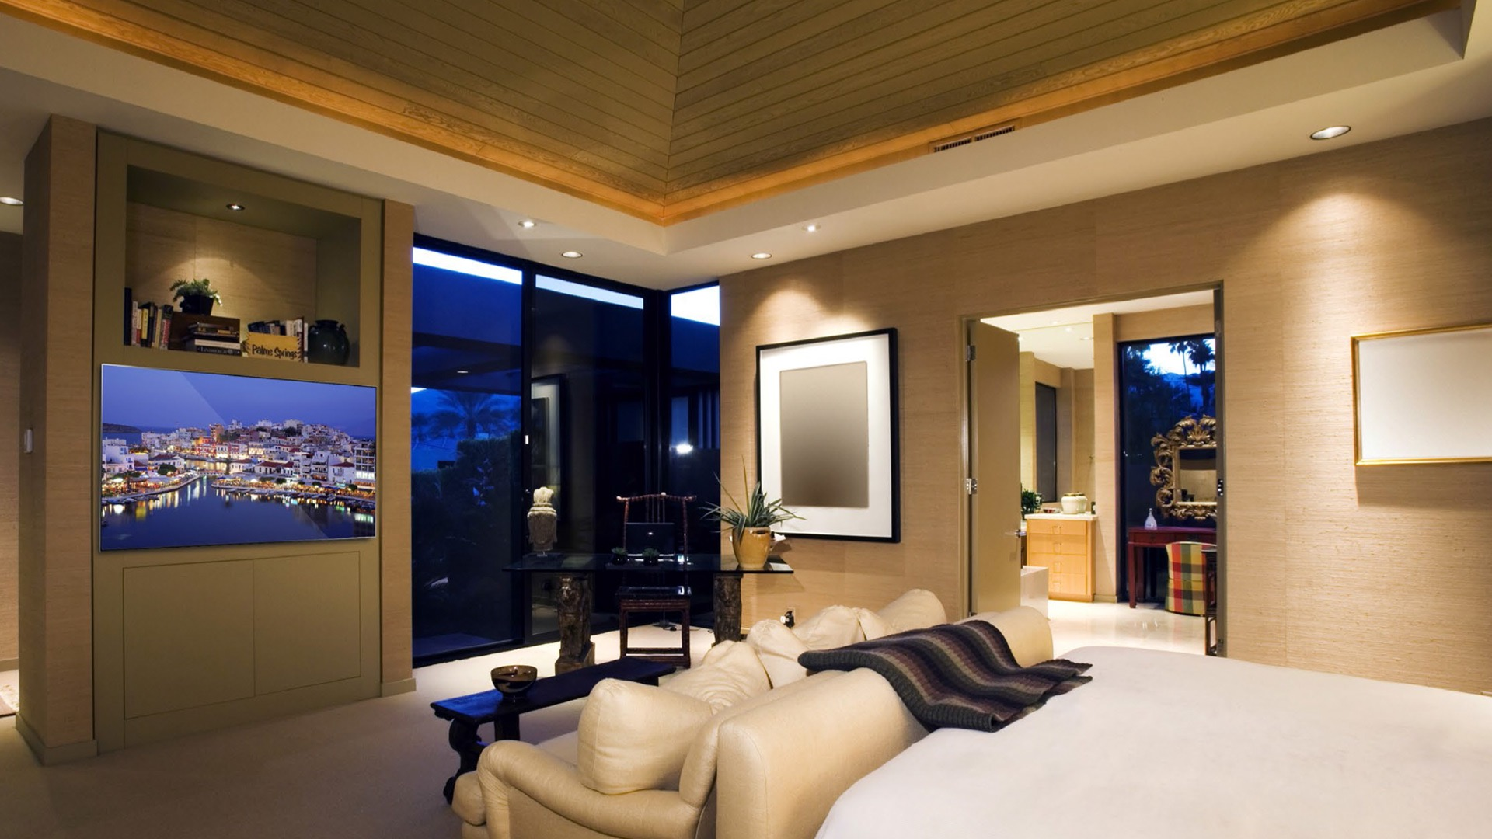
Samsung Hotel TVs

Slide 38
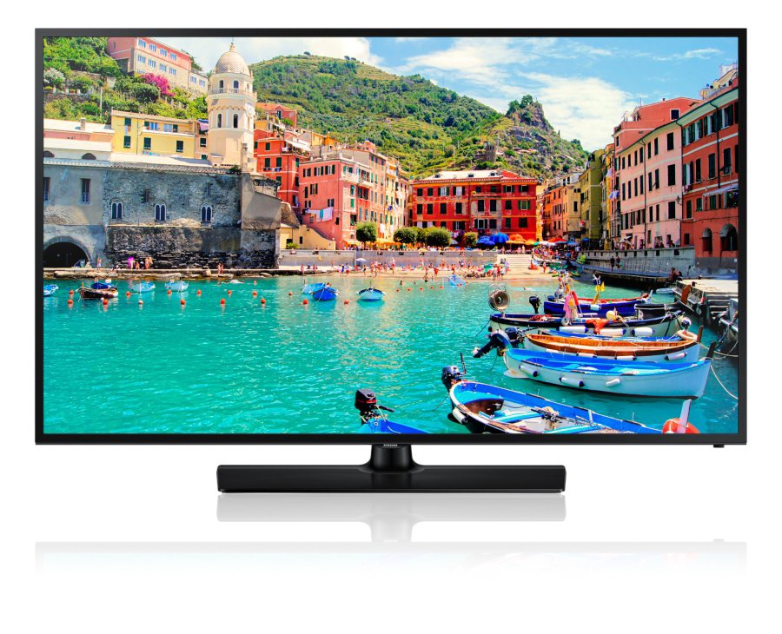
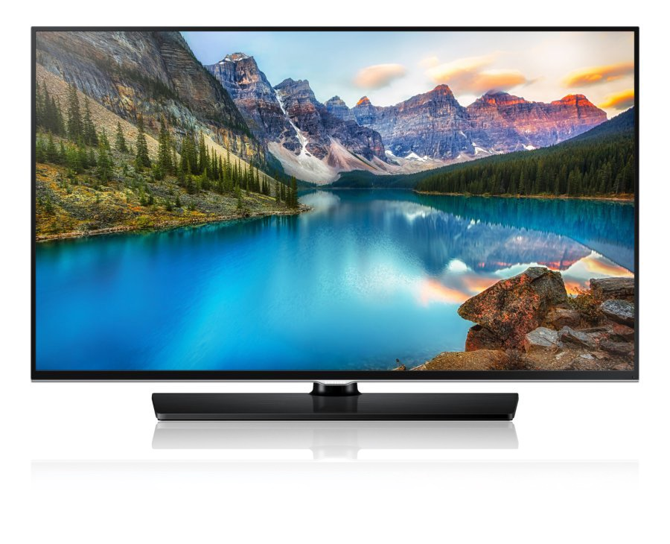
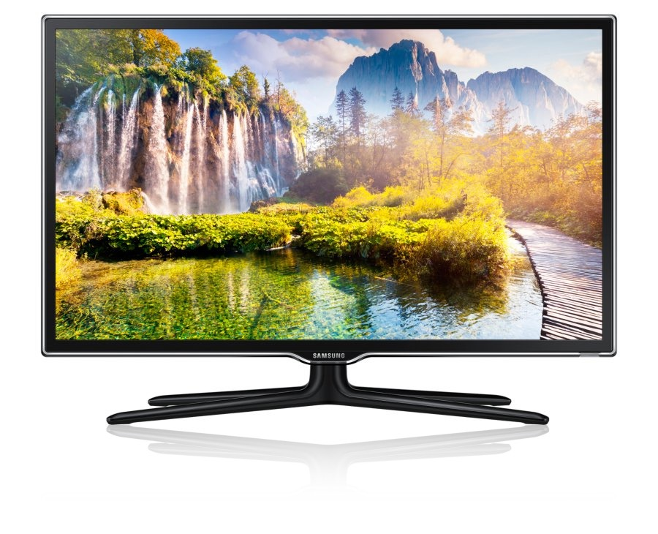
Professional hotel TVs by Samsung
Samsung HD490
32" / 40"
WebOS SMART platform
Samsung HD690
24" / 28" / 32" / 40" / 48" / 55" WebOS SMART platform
SLIM design
Samsung HD790
60” / 55” / 49” WebOS SMART platform
ULTRA SLIM design

Slide 39

Thank you!

